Slide 1
MUNCH
Progress Report #2
Gabriel Soares & Gabriel Mendonca

Slide 2
Table of Contents
01
02
03
04
Figma Updates
Search V1
Next Steps
Questions?

Slide 3
01
Figma Updates

Slide 4
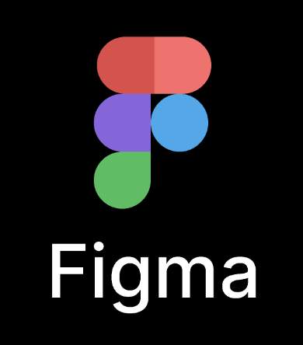
UI/UX Figma Design
Home Screen: Simplify with a prominent search bar for natural language queries.
Conversational Interface: Implement a chat-like UI for AI interactions.
Results Screen: Visual cards for restaurant info, including photos and ratings.
Restaurant Details: Provide comprehensive info with menu, map, and booking options.
Preferences: Allow users to set dietary and cuisine preferences in their profile.
User Flow: intuitive journey from query to restaurant selection, optimizing for fewer steps

Slide 5
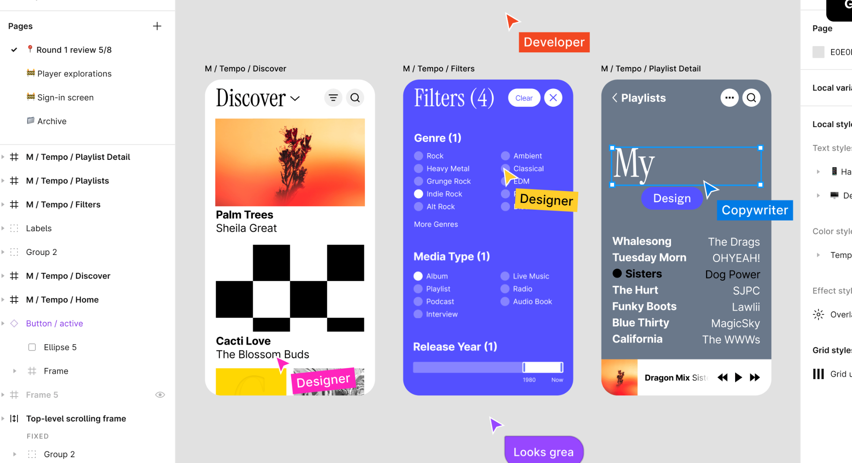

Slide 6
02
Search V1

Slide 7



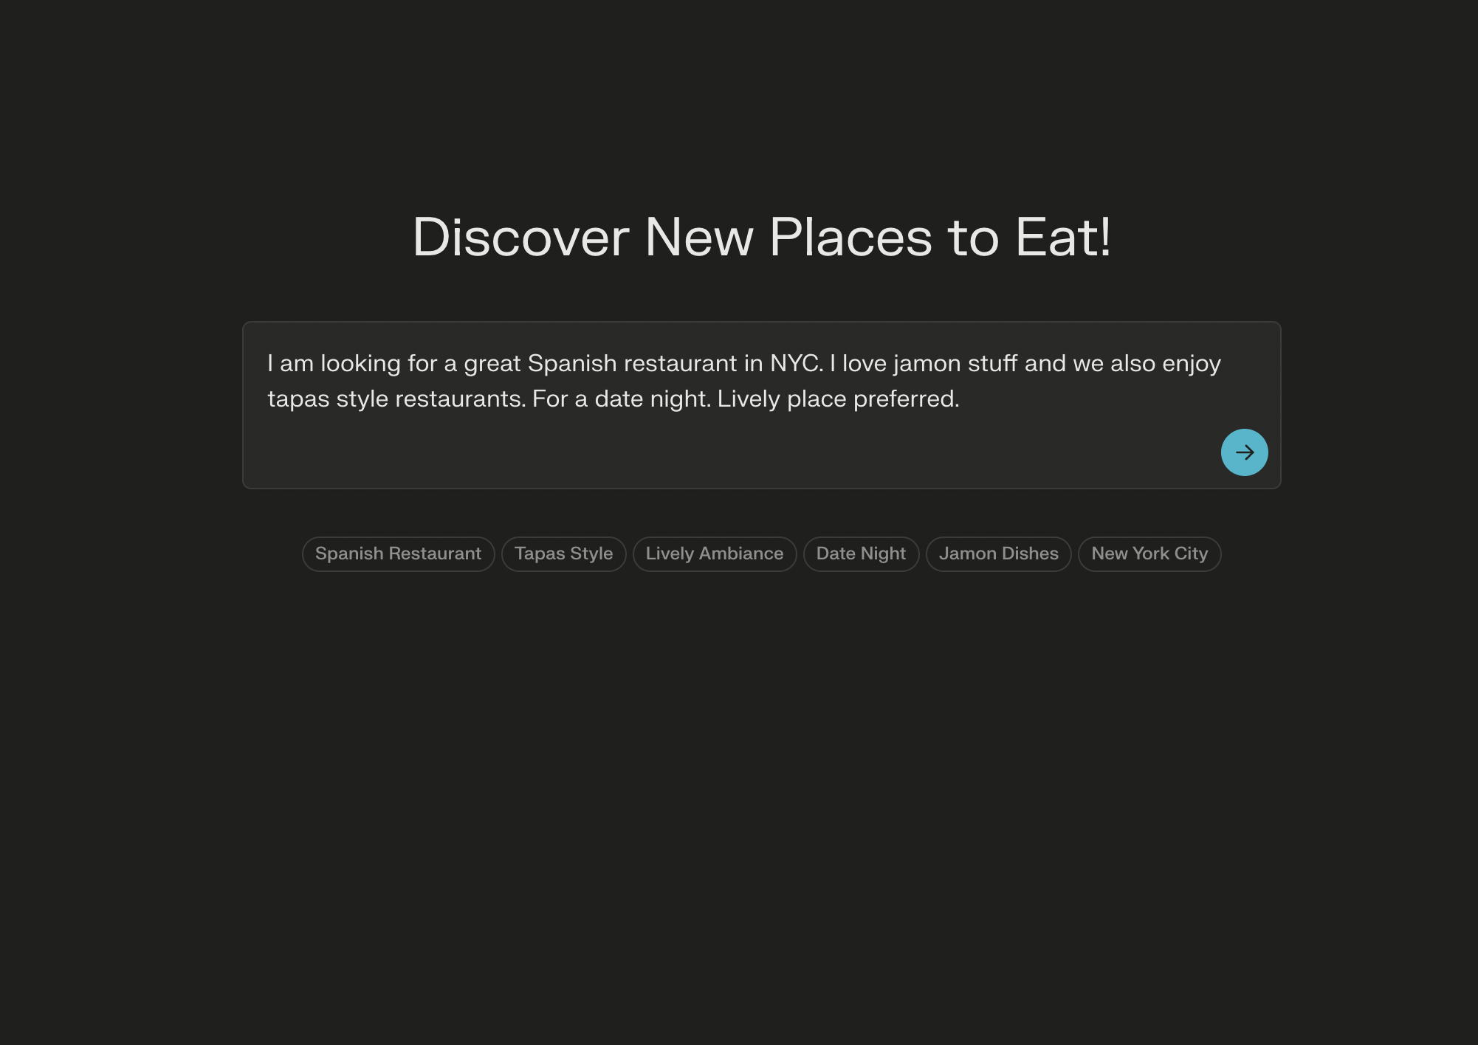
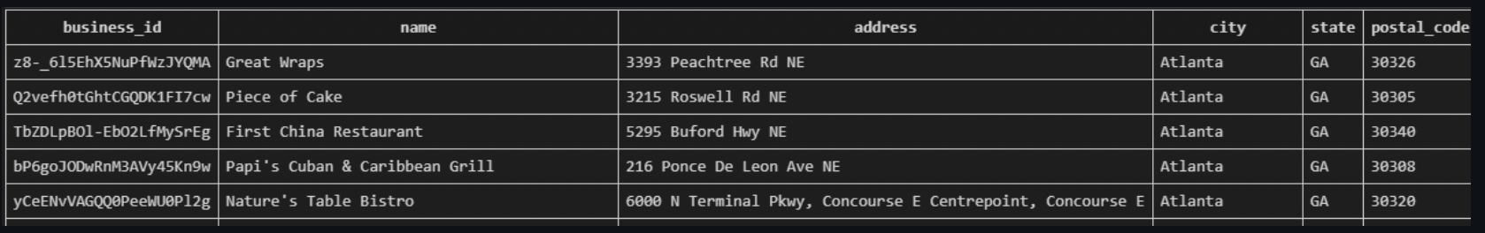
Progress Update + Demo:
Database Filtering from Natural Language Query
Step 1: Send to GPT4 Pandas Query Agent:
User’s query
Database schema
Special prompt
Step 2: GPT4 returns to the backend only the custom pandas code necessary to perform the filtering.
Step 3: Llama Index’s agent executes the code, filtering the dataset based on the identified hard criteria.

Slide 8
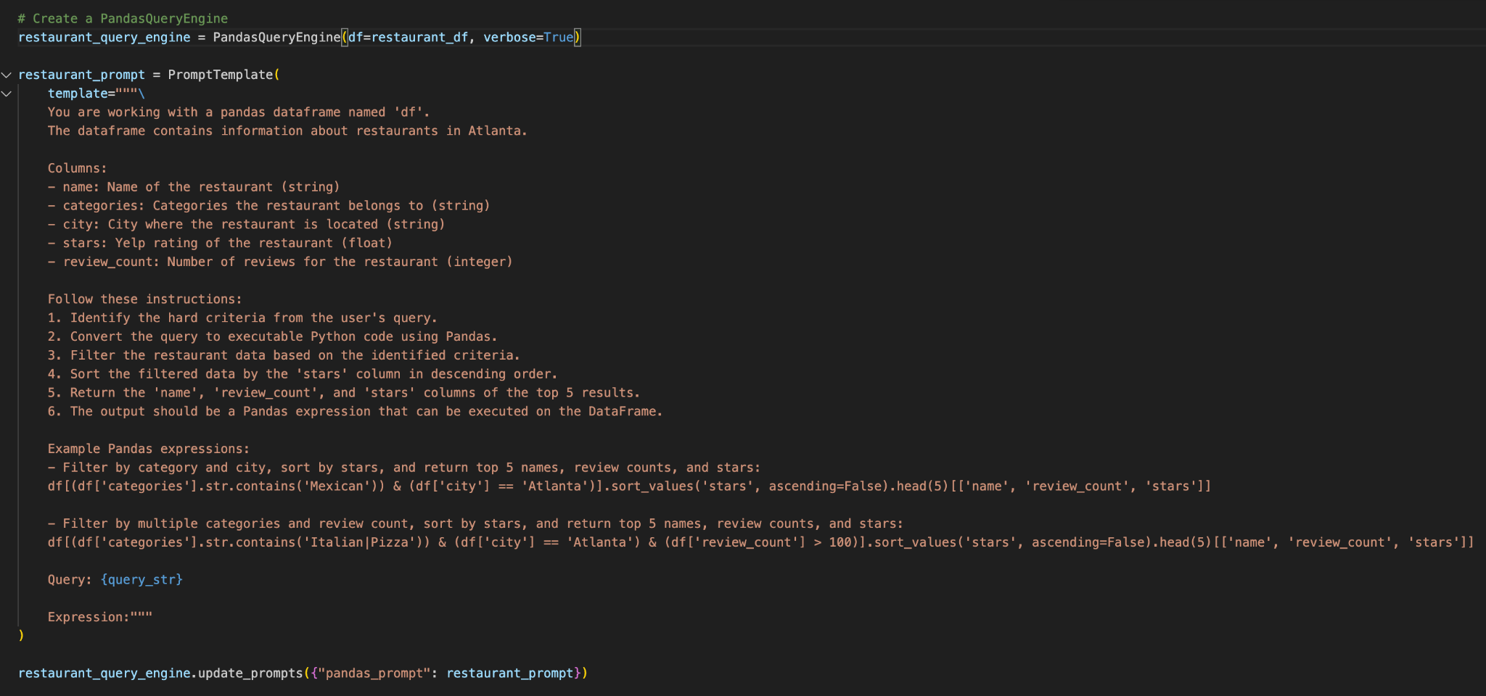
Prompt for Pandas Query

Slide 9
DEMO

Slide 10
03
Next Steps

Slide 11

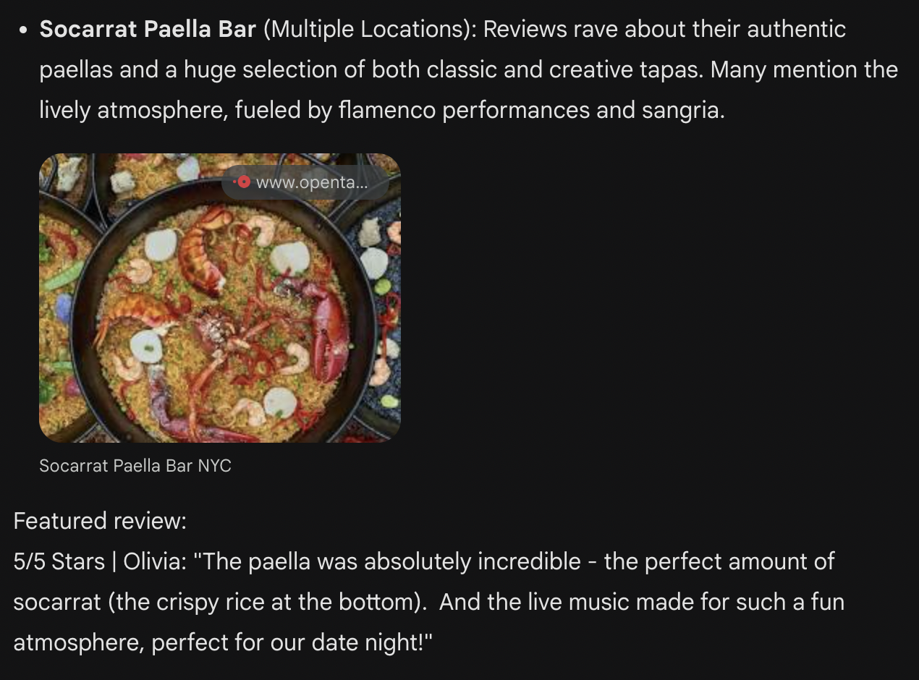
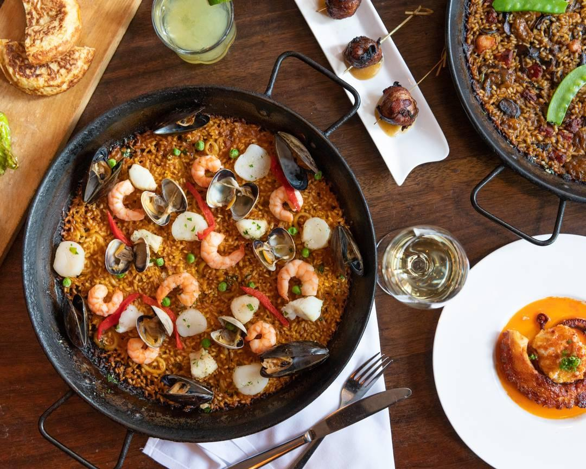
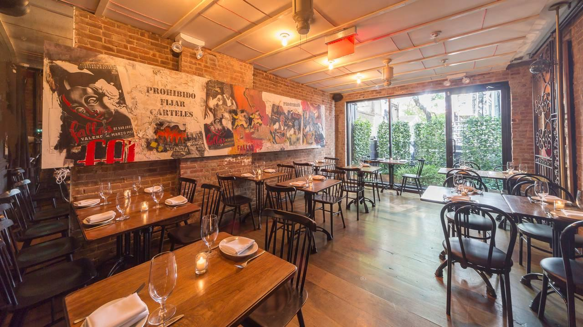
What To Work on Next

Slide 12
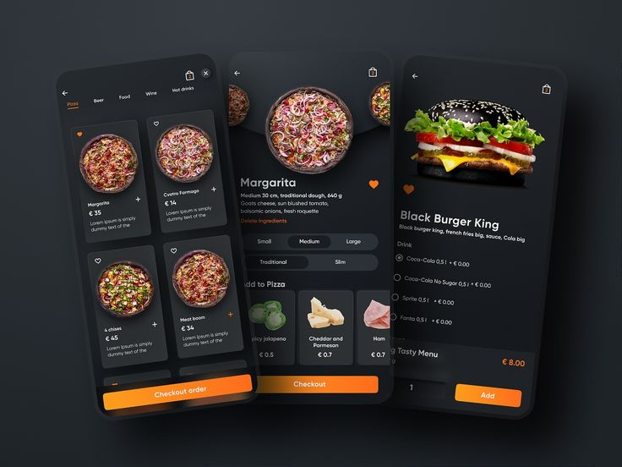
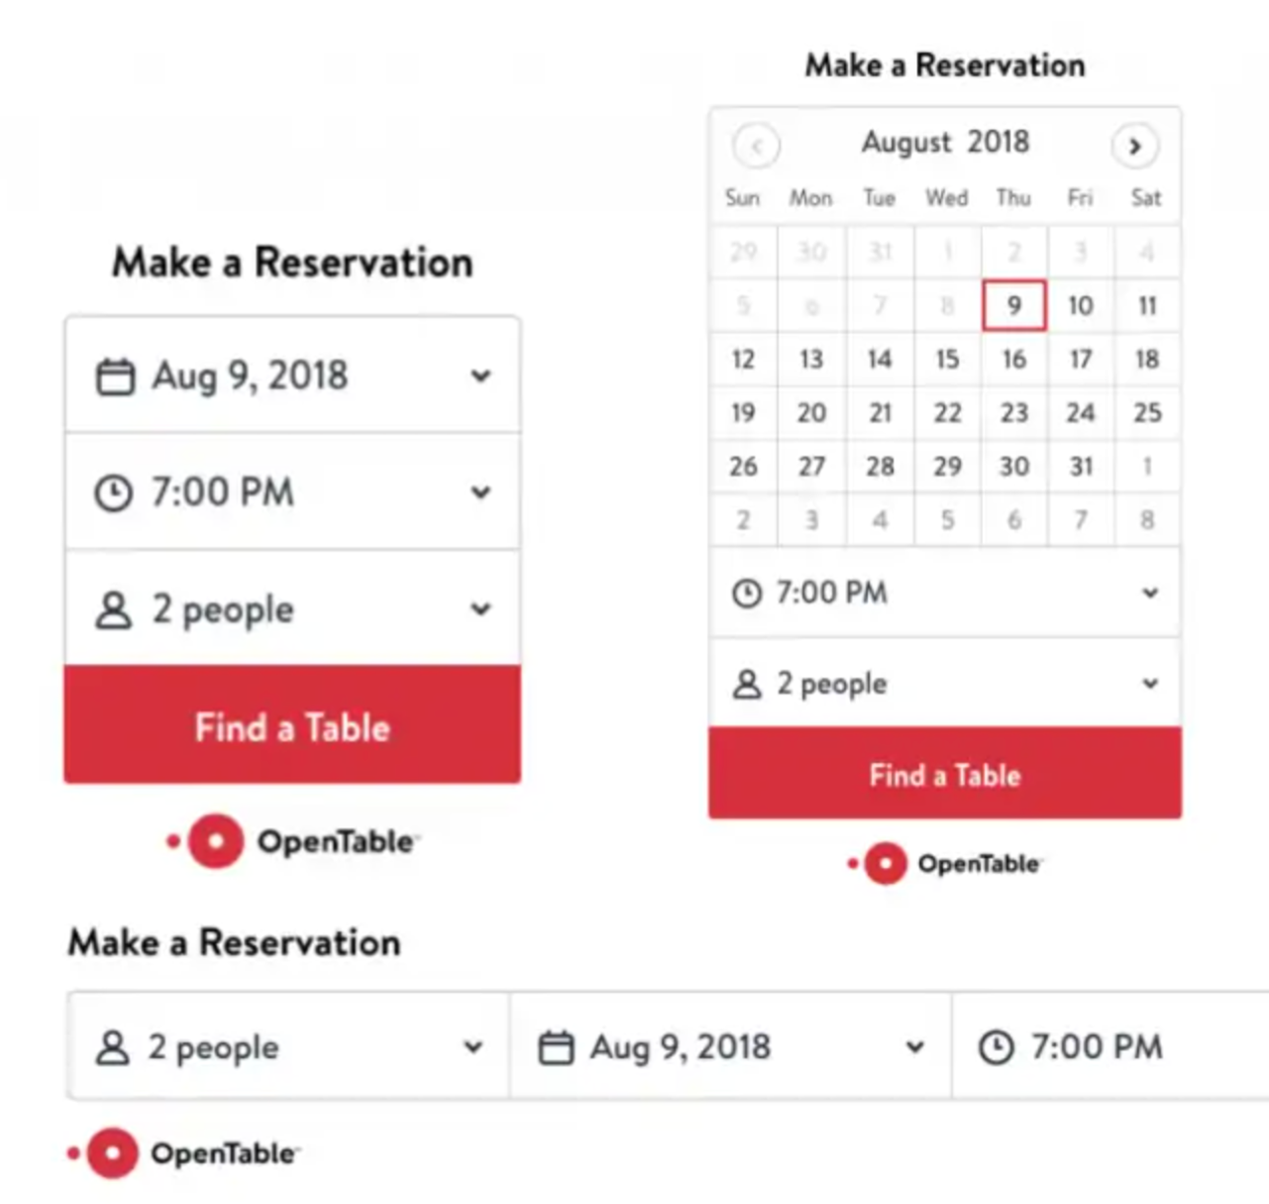
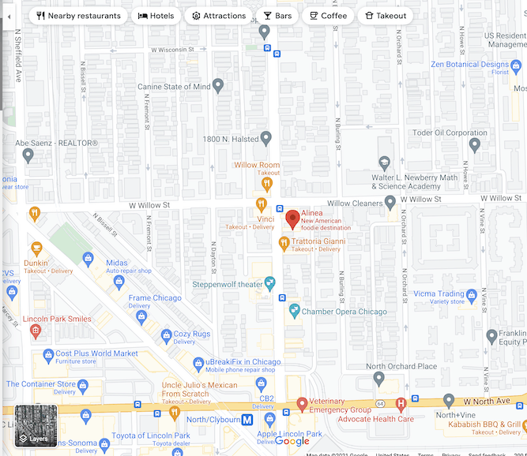
Future Features to Implement
RESTAURANT MENUS
RESERVATIONS
DIRECTIONS

Slide 13
Project Timeline
Week 1-2 (Feb 20 - Mar 5)
Finalize Restaurant Search V1.
Setup GitHub and Trello for tasks.
Finalize entire project concept and decide what features the app will have + tech stack to build.
Week 7-8 (Apr 3 - Apr 16)
Finalize Llama search V2 (include RAG and review dataset logic for better ranking).
Prototype of the overall app for testing.
Polish UI and UX designs.
Week 3-4 (Mar 6 - Mar 19)
UI/UX Design: Draft initial Figma designs and user flow wireframes.
Optimize restaurant search V1 - Expand filtering capabilities and polish LLM response structure.
Week 9 (Apr 17 - Apr 23)
Finalize React Native frontend development.
Conduct intense testings on the search feature and polish the algorithm/add missing features.
Week 5-6 (Mar 20 - Apr 2)
Finalize development of backend infrastructure.
User authentication implemented.
Basic frontend React Native version working.
Figure out data storing and app hosting
Week 10-11 (Apr 24 - May 1)
Fully ready V1 of the app.
Address any remaining issues or bugs.
Present final project & collect feedback for improvements.

Slide 14
Thanks!
Any questions?

